Slide 1
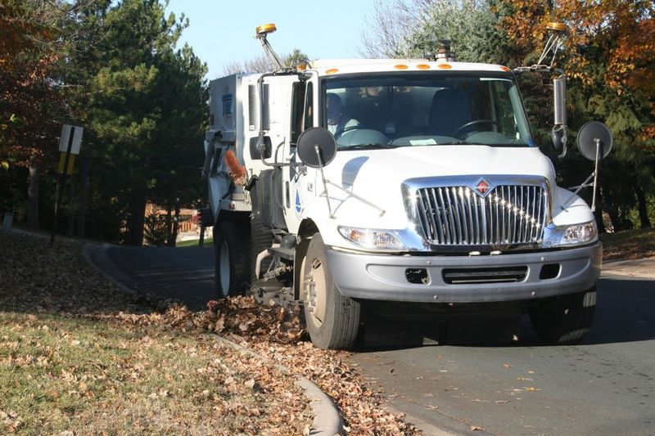

Street Sweeping Webinar
Thursday, May 13, 2021
Minnesota Pollution Control Agency
Image courtesy Sarah Hobbie, University of Minnesota

Slide 2
Speakers
Dr. Sarah Hobbie, University of Minnesota: Trees and nutrients
Aileen Molloy, Tetra Tech: Street sweeping tool
Hillary Yonce, Tetra Tech: Draft sweeping guidance
William Selbig, USGS Upper Midwest Water Science Center: Street sweeping research
Opening statement: Randy Neprash, Stantec

Slide 3
Acknowledgements
University of Minnesota
  Sarah Hobbie
  Larry Baker
  Jacques Finlay
  Tessa Belo
  Rachel King
Staff from the cities of Roseville, Shoreview, Minneapolis, Forest Lake, and Prior Lake
Technical Support Team
  Dan Curley
  Mike Kinney
  Paula Kalinosky
  Randy Neprash
  Ross Bintner
  Ryan Johnson
  Steve Gurney
  Todd Carlson
TetraTech

Slide 4
Some logistics
Webinar is being recorded
1.5 PDH offered
Please put questions in the chat box; will likely defer questions to the end
Everyone is muted; we can unmute if necessary
Everything will be posted in the Minnesota Stormwater manual on the page called Stormwater Manual webinars

Slide 5
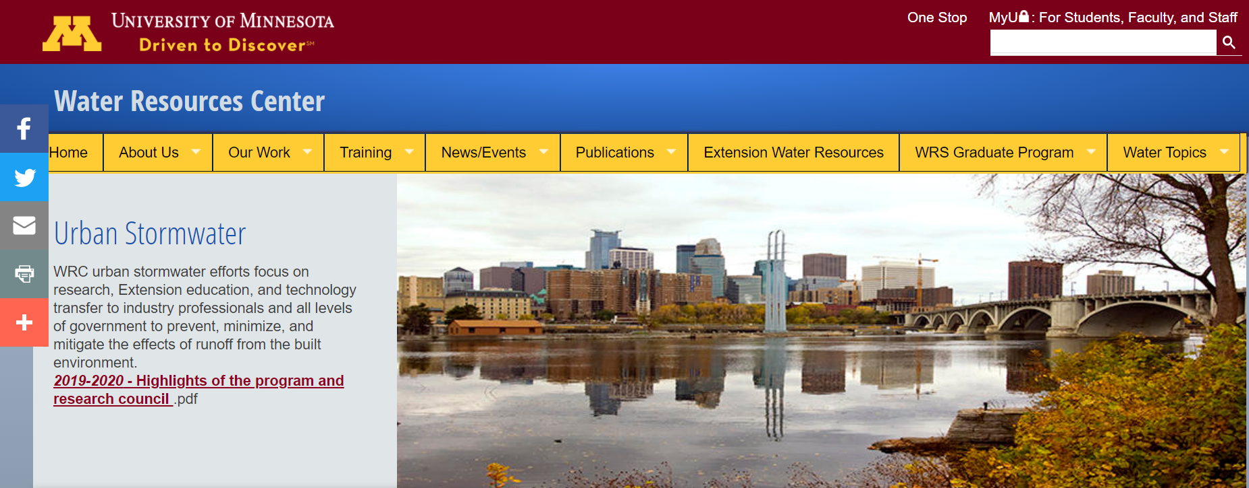
Street sweeping project highlights
Street sweeping can be a cost-effective practice for reducing phosphorus loads
MPCA lacked a phosphorus credit for street sweeping
Wanted a credit based on material collected
U of M worked with cities to develop relationships between material collected and P
Tetra Tech developed a simple Excel workbook to calculate a P credit
Street sweeping guidance is currently being developed
There is a lot we don’t know yet

Slide 6

Randy Neprash: Stantec
The importance and value of street sweeping

Slide 7
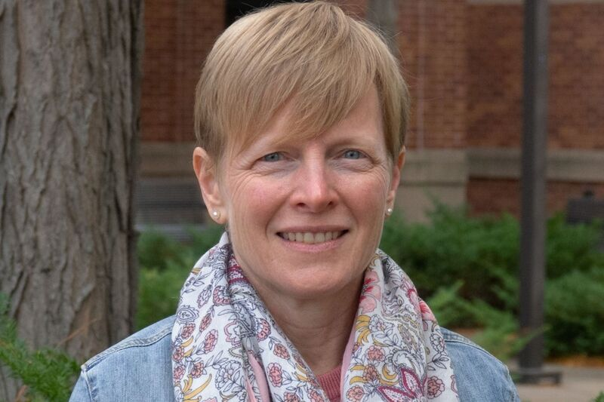
Dr. Sarah Hobbie: University of Minnesota
Trees as a source of nutrients in urban stormwater

Slide 8
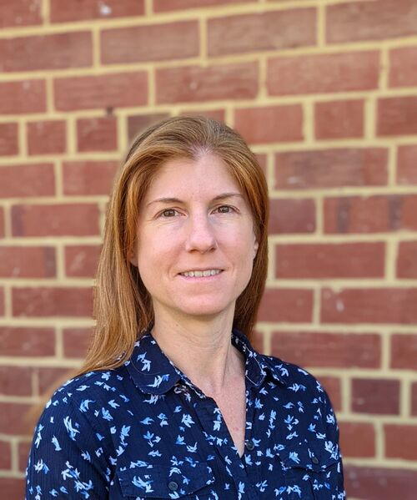

Aileen Molloy, Hillary Yonce: Tetra Tech
Street sweeping calculator and draft guidance for sweeping

Slide 9
Please indicate in the chat box if you are interested in any of the following for the tool and guidance
Training workshop
Video(s)
Case studies
Some other communication (please specify)

Slide 10
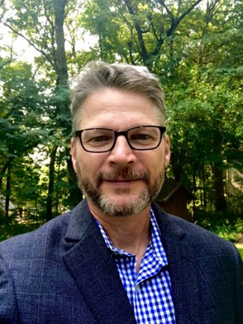
William Selbig: United States Geological Survey
On-going research and research needs

Slide 11
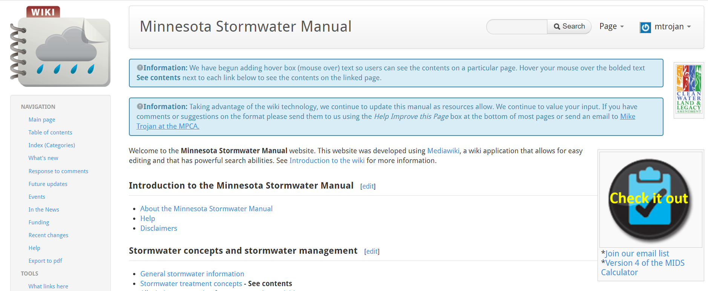
Some shameless self promotion
If interested, join our email list
Webinar on engineered/bioretention media, May 26, 9:30

Slide 12
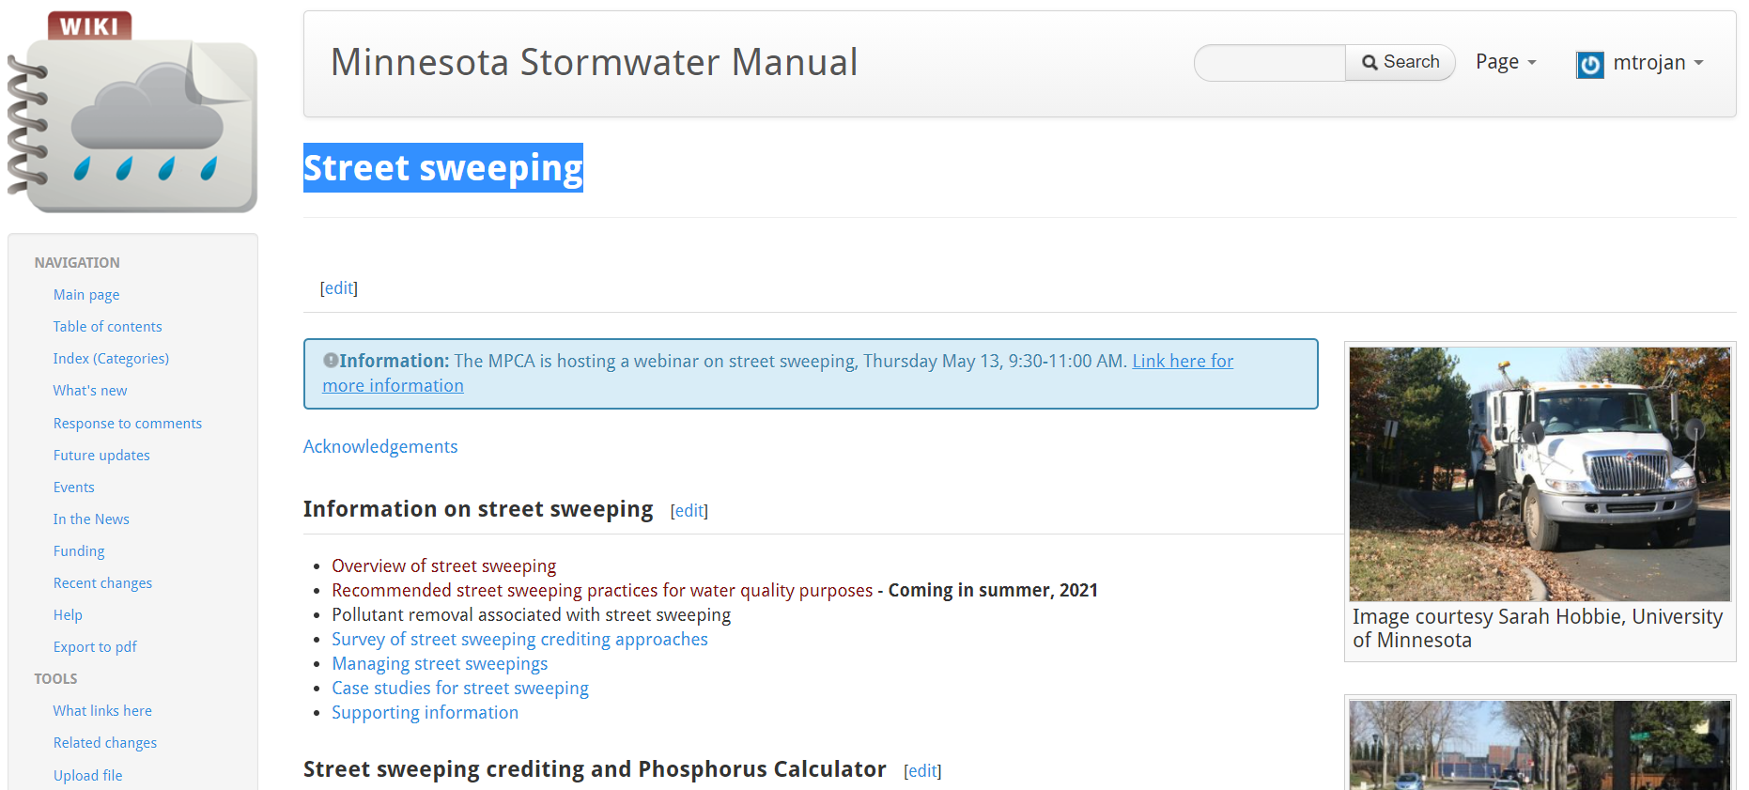
Stormwater Manual links
Webinar info and pdh certificate located on page called Stormwater Manual webinars
All the info on street sweeping is on a page called Street sweeping (gradually being populated)
Mike.trojan@state.mn.us

