Slide 1
Street Sweeping Credit Calculator
May 13, 2021
Aileen Molloy, Tetra Tech

Slide 2
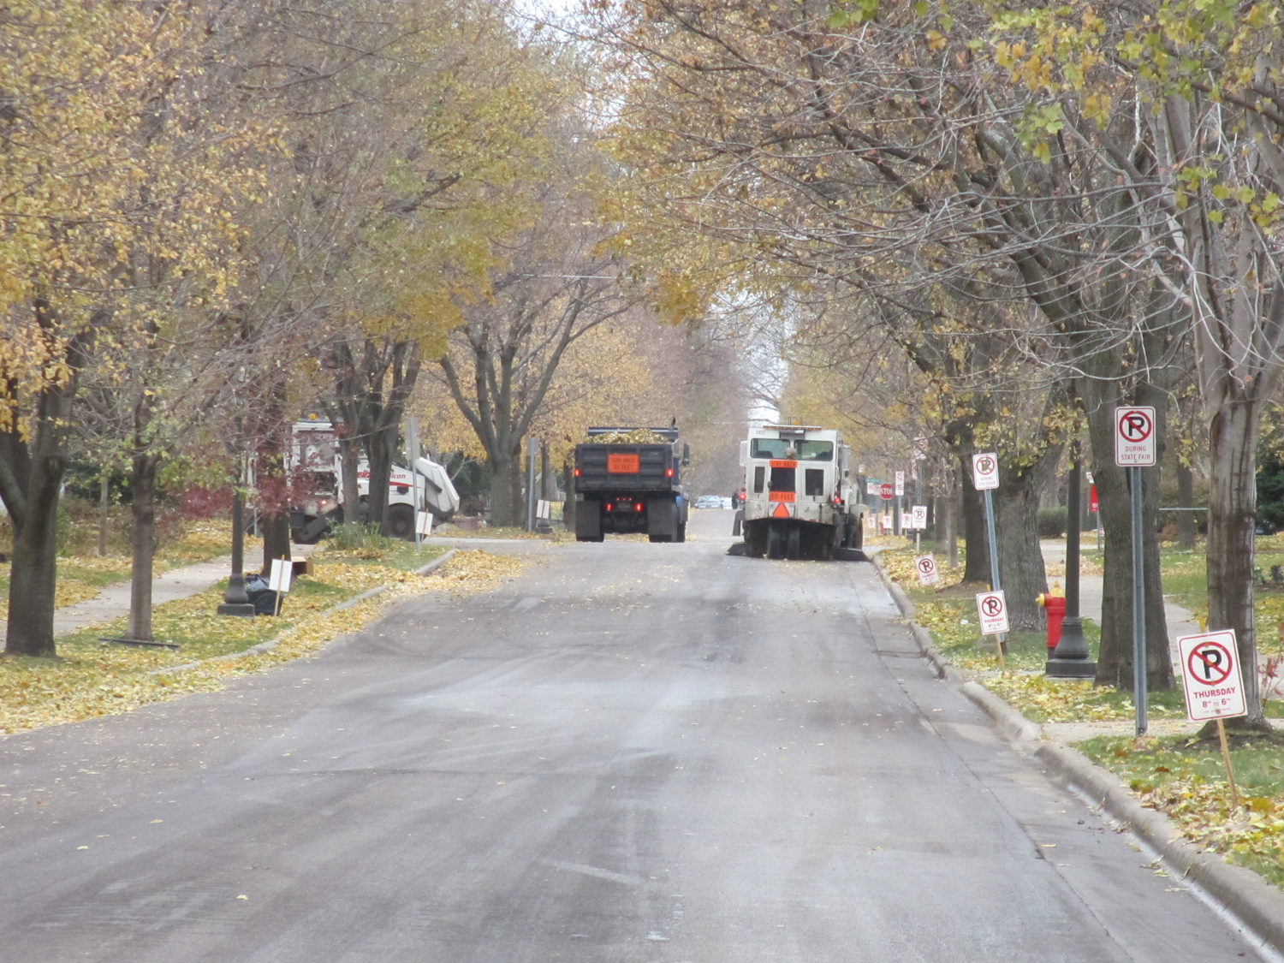
Street Sweeping for Water Quality Improvements
MPCA is developing a stormwater phosphorus crediting program for street sweeping
Calculator Tool was developed after reviewing other established crediting methods

Slide 3
Crediting Method
No existing state-certified credit in Minnesota
Preferred an approach that is data-driven, encourages practitioners to measure swept materials
Survey of municipalities
  70% already measure volume or mass of swept materials
Methods Considered
  Direct measure of TP concentration
  Surrogate measures via dry mass, wet mass, volume
  Modeling

Slide 4
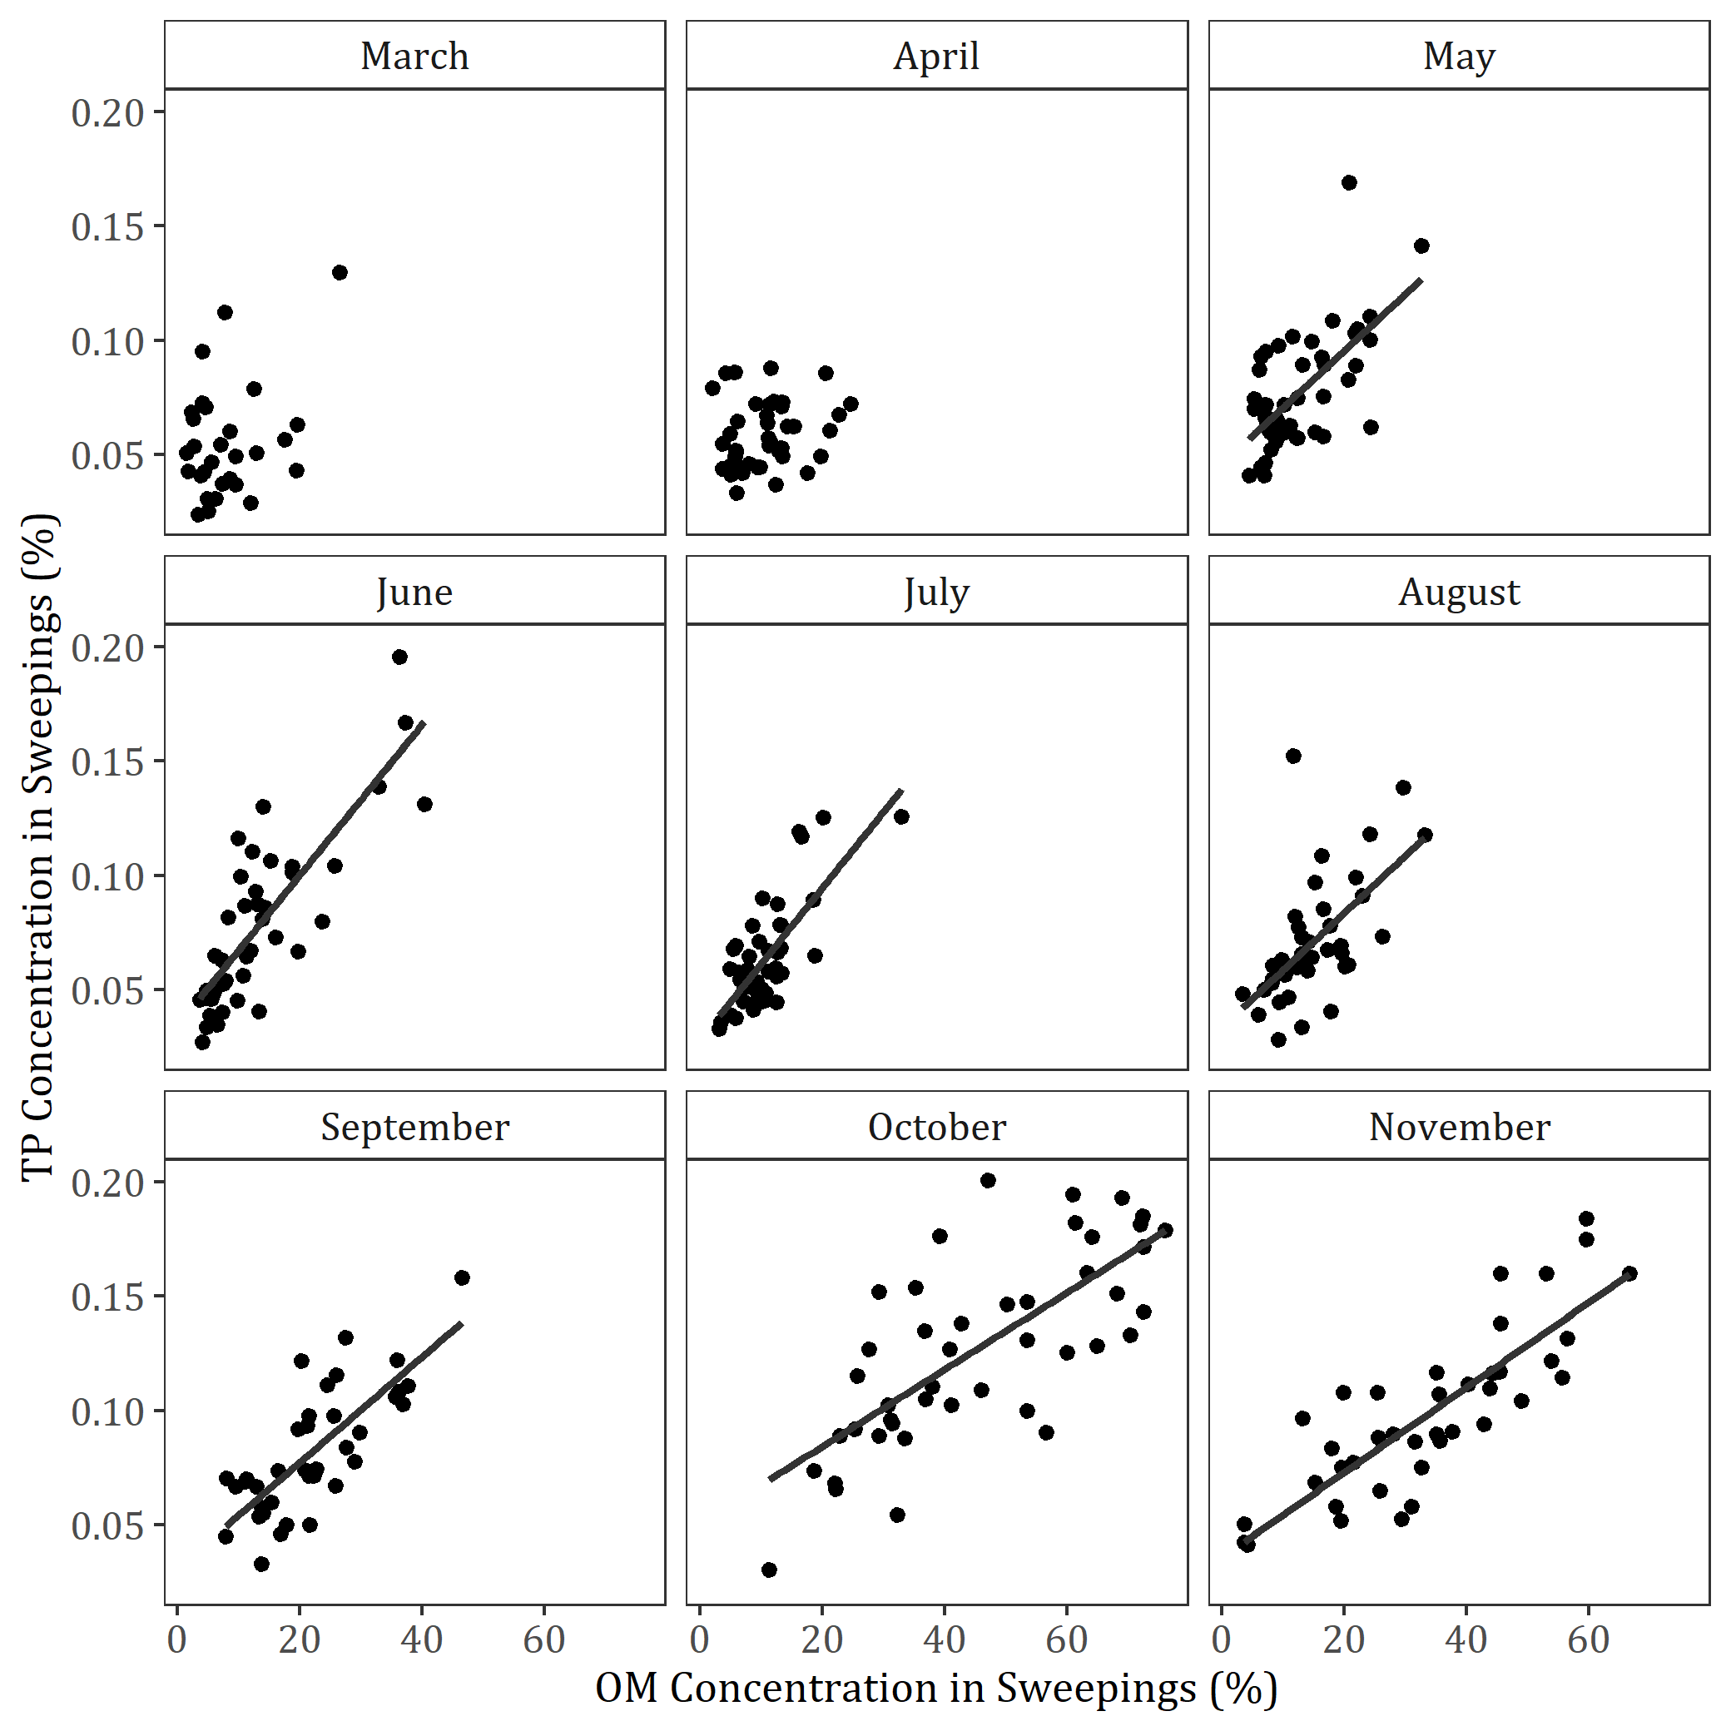
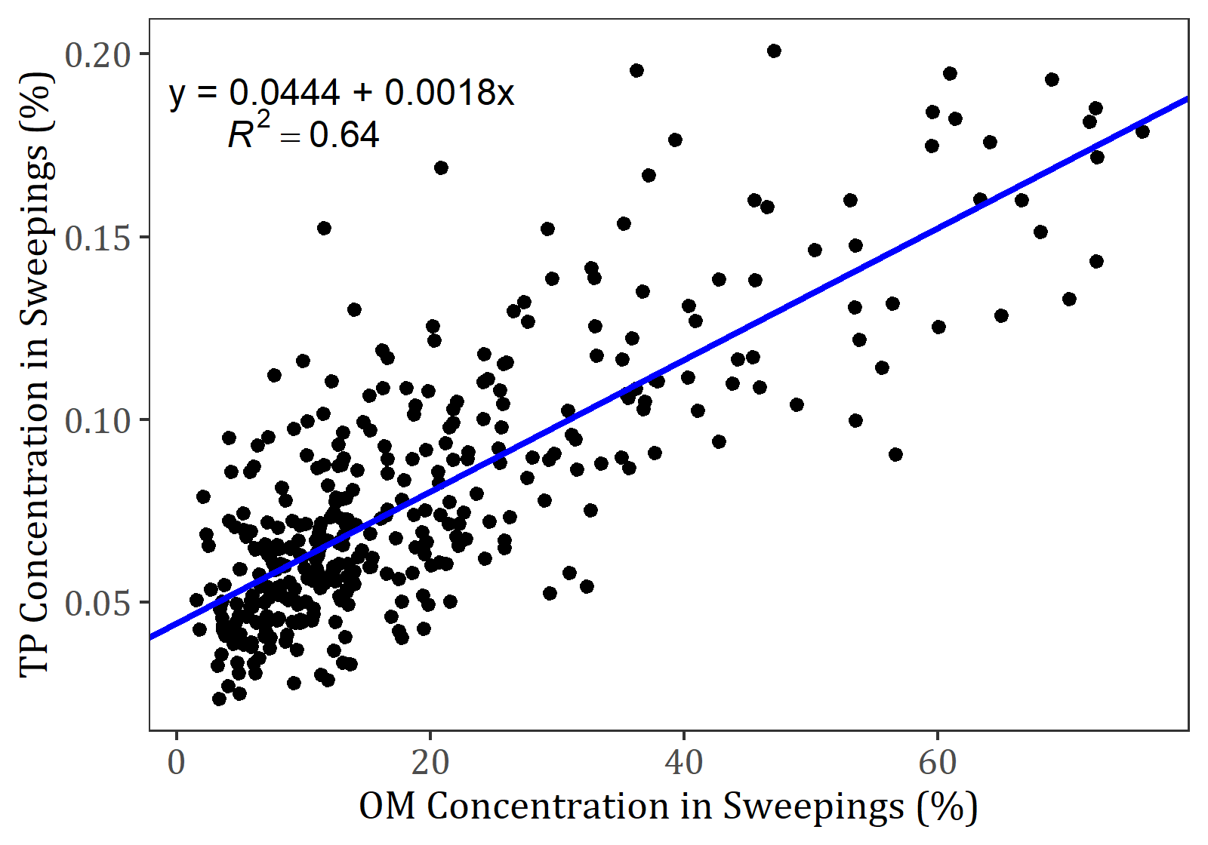
Predicting TP concentration in sweepings from organic matter concentration
Relationship by month
Overall relationship

Slide 5
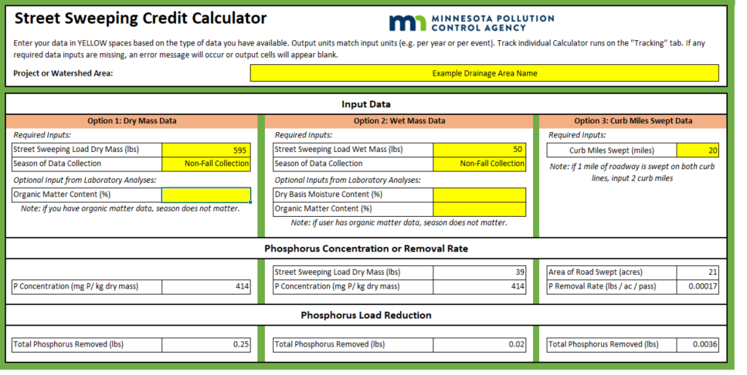
Street Sweeping Credit Calculator Tool

Slide 6
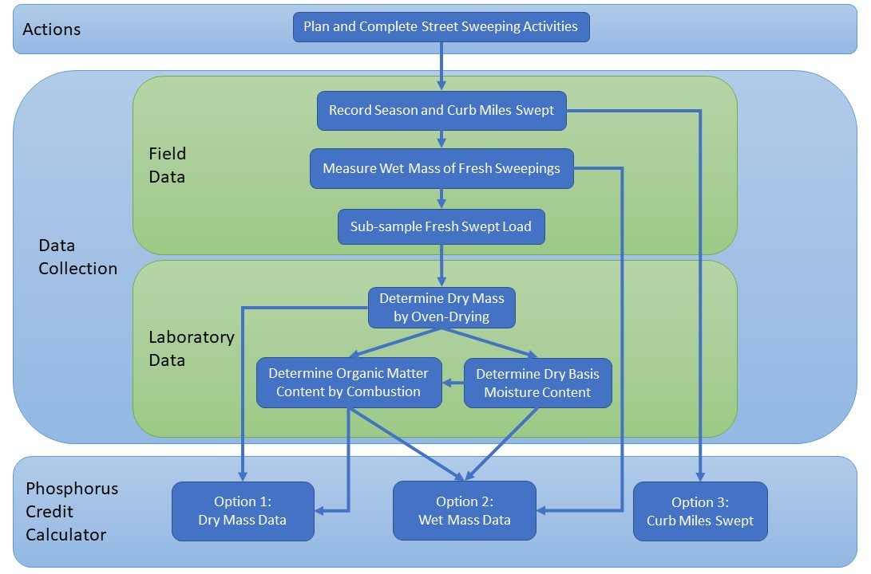
Selecting the Crediting Method

Slide 7
Calculator Demonstration

