Slide 1
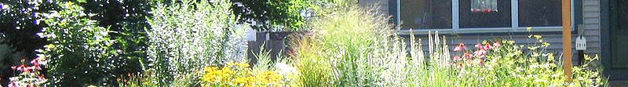
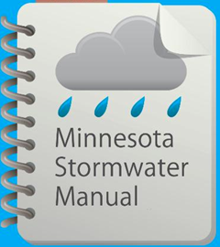



Updates to the Minnesota Stormwater Manual
Infiltration Practices
December 15, 2016

Slide 2
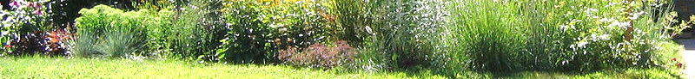
Professional development hours
1.5 PDHs offered
Send an email to Mike.Trojan@state.mn.us. We will check against attendance and send certificate.

Slide 3
This Powerpoint will be available in the Stormwater Manual after this webinar
On the Stormwater Manual Table of Contents page, scroll down to Communications and Outreach and click on Stormwater manual webinars

Slide 4
Polls
We are not doing polls during this webinar but will in the future
We will send a survey after the webinar to attendees asking four questions
  Who you work for
  How often you use the manual
  Interest in MIDS calculator workshops
  How this webinar went

Slide 5
Upcoming webcasts
Mid to late January: Stormwater/rainwater harvest and use/reuse
Mid March: Updates to the Minimal Impact Design Standards Calculator
Let us know what topics you are interested in

Slide 6
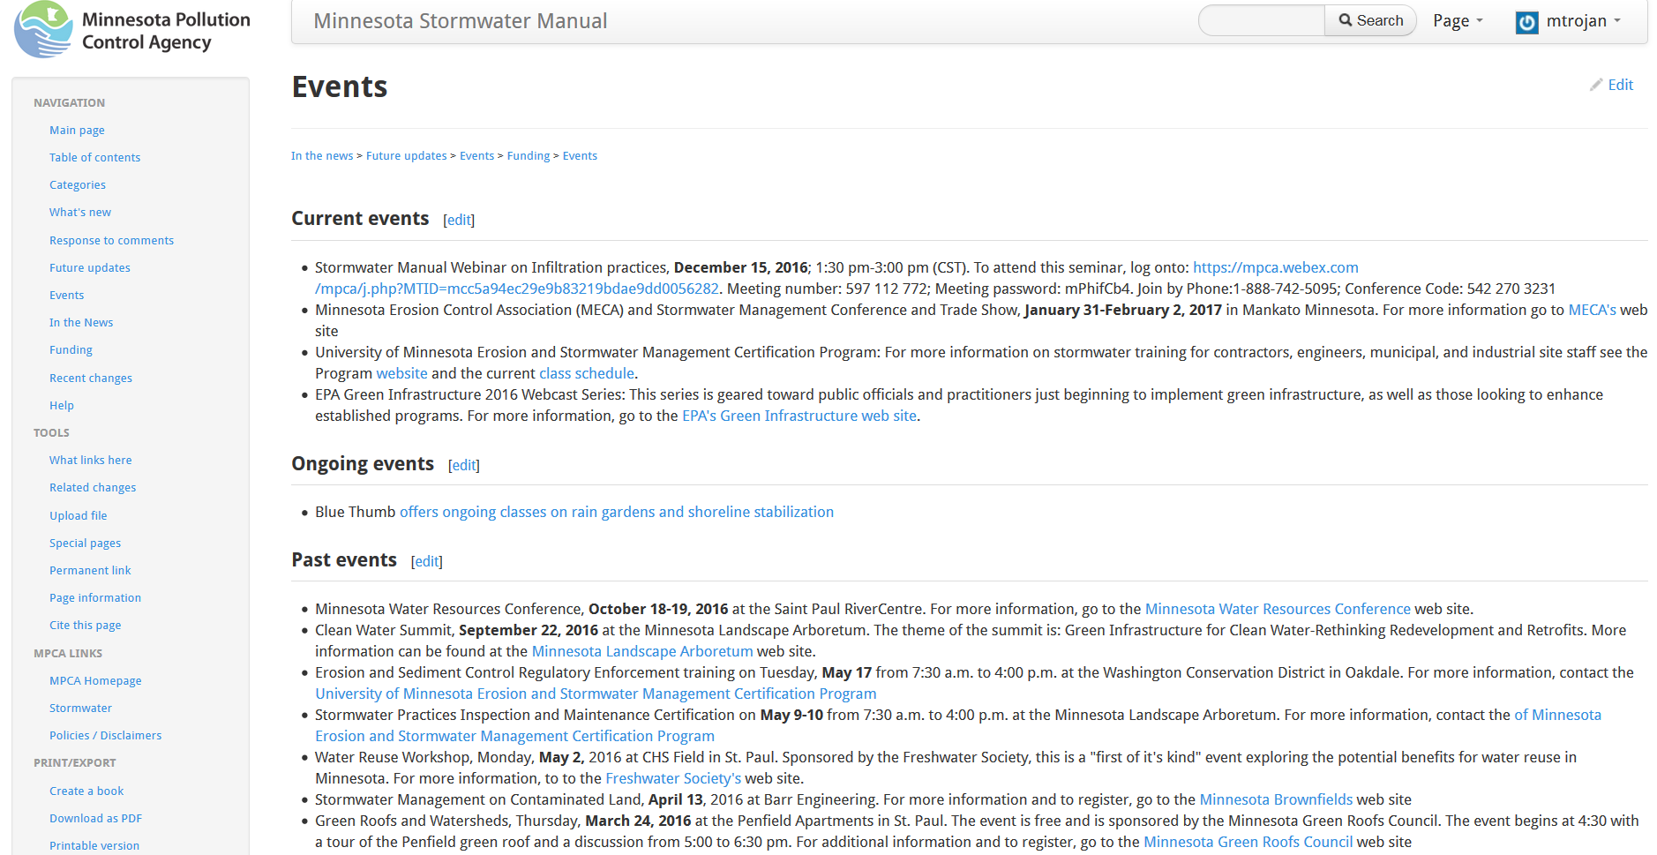

Slide 7

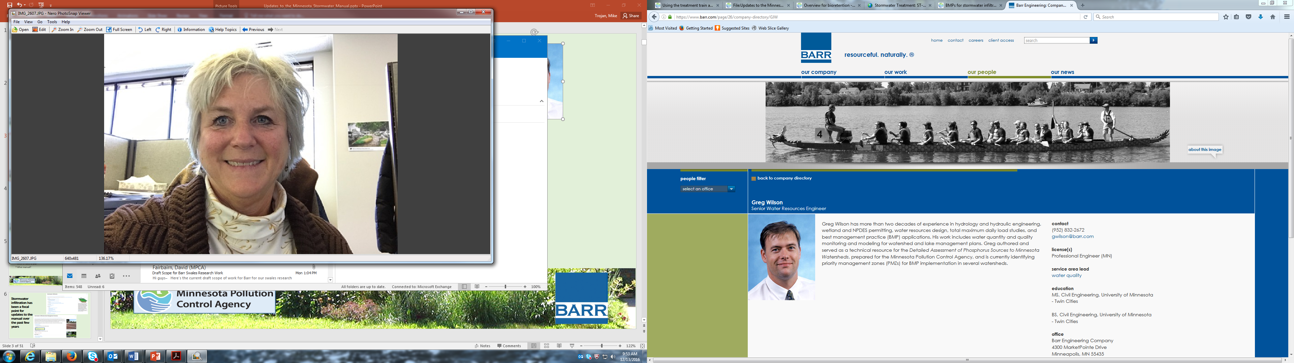

Presenters
Greg Wilson, Barr Engineering
Anne Gelbmann, Minnesota Pollution Control Agency
Mike Trojan, Minnesota Pollution Control Agency
Contact information
  Mike.Trojan@state.mn.us
  MN Stormwater Manual – (easier to find with a Google search) http://stormwater.pca.state.mn.us/index.php/Main_Page

Slide 8
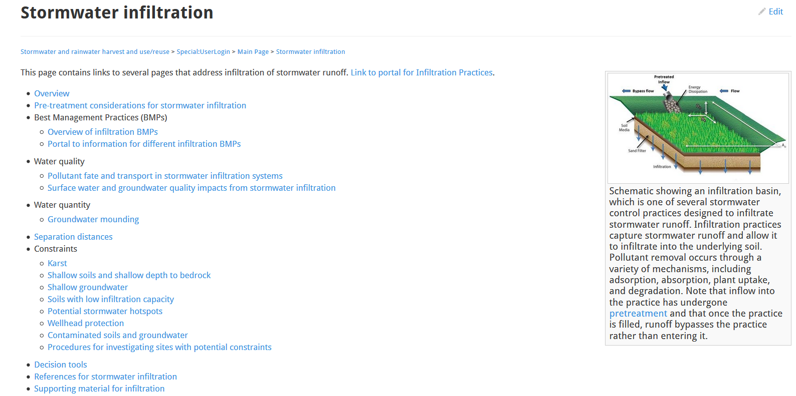
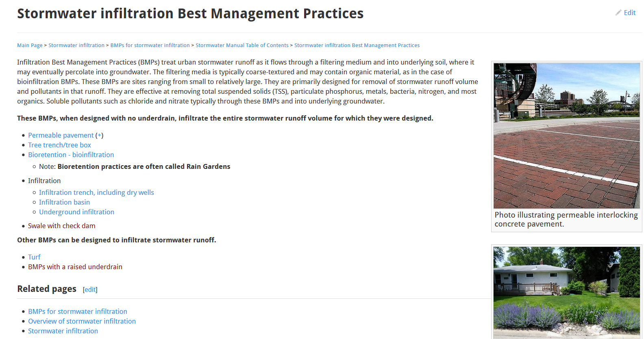
Stormwater infiltration has been a focal point for updates to the manual over the past few years

Slide 9
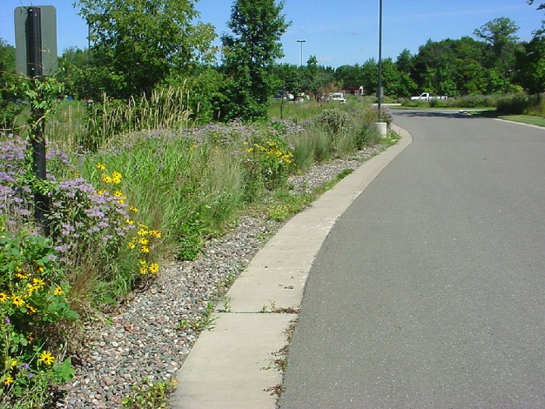
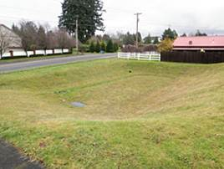
The MPCA executed a work order with the following objectives
Provide new information and update existing information on infiltration practices
Focus on infiltration basin, infiltration trench, underground infiltration, and dry well
Ensure consistency between all infiltration BMPs

Slide 10
Contractor: Barr Engineering
Greg Wilson – Project Manager; PE, Senior Water Resources Engineer
Matt Kumka: Landscape Architect
Michelle Kimble: PE, Civil Engineer
Heather Hlavaty: Water Resources Specialist
Kristin Alstadt: PE, Geotechnical Engineer
Patrick Brockamp: Water Resources Engineer
Brendan Dougherty: ENV SP, Landscape Ecologist
Fred Rozulmalski: RLA, Landscape Ecologist
Henry (Hal) Runke: PhD, Vice President, Limnologist
John Hanson: PE, Vice President, Senior Civil Engineer
Kurt Leuthold: LEED AP, PE, Vice President, Senior Civil Engineer
Josh Philips: Water Resources Engineer
Alexa LaQua: Geotechnical Engineer
Eric Novotny: PhD, Water Resources Specialist
Candice Kantor: PE, Water Resources Engineer

Slide 11
Technical Support team
Lois Eberhart: Water Resources Administrator, City of Minneapolis
Jim Hafner: Stormwater Manager, City of Blaine
Mike Isensee: CPESC, Administrator, Middle St. Croix Watershed Management Organization Watershed Specialist, Washington Conservation District
Karen Jensen: Environmental Analyst, Environmental Services, Metropolitan Council of the Twin Cities
Forrest Kelley: Regulatory and Construction Program Manager, Capitol Region Watershed District
Randy Neprash: PE, Minnesota Cities Stormwater Coalition

Slide 12
Scope of Work for infiltration practices
Update the following pages in the manual
  Overview for infiltration
  Types of infiltration
  Design criteria for infiltration
  Construction specifications for infiltration
  Operation and maintenance for infiltration
Create new pages
  Understanding and interpreting soils and soil boring reports
  Case studies for infiltration
Update the information on cold climate suitability

Slide 13
Presentation outline
Summary of information
Tour of infiltration section in the manual
MIDS calculator
Q&A

Slide 14


Watch for these during the presentation
New information
Updated/changed information
No change
No change in existing information

Slide 15
Types of infiltration practices covered in manual
Bioinfiltration
Permeable pavement
Tree trench/tree box
Swale with check dam (not currently in manual)
Infiltration – includes the following based on similarity in design, construction, O & M
  Infiltration trench, including dry wells
  Infiltration basin
  Underground infiltration

Slide 16
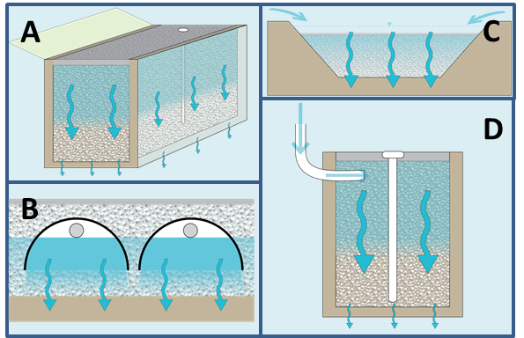
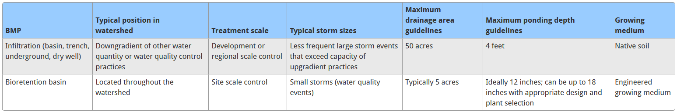
Infiltration vs. bioinfiltration
No change
A = infiltration trench
B = underground infiltration
C = infiltration basin
D = dry well

Slide 17
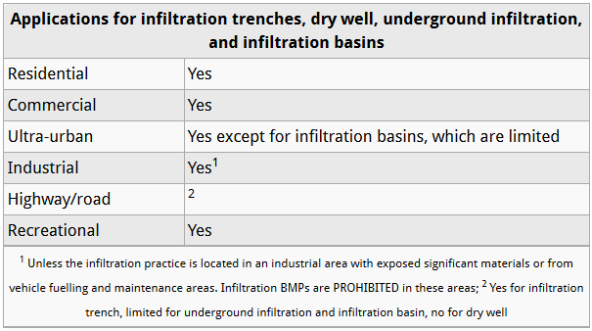
Applications for infiltration

Slide 18
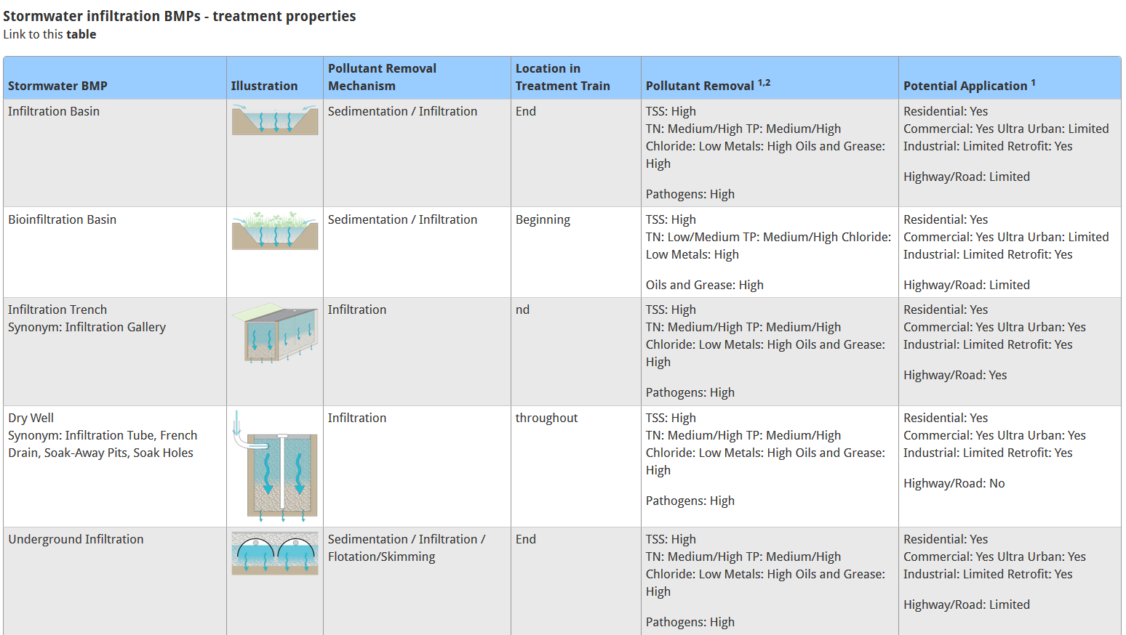
Properties

Slide 19
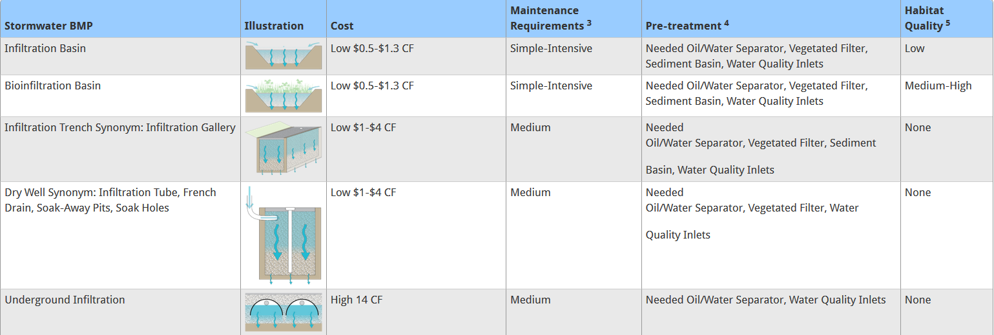
Properties

Slide 20
Design elements

Slide 21

Contributing area to infiltration practices

Slide 22
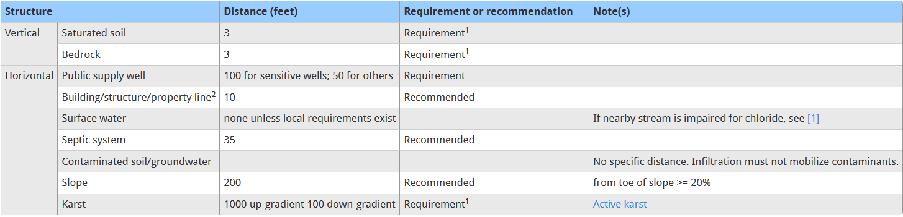
Site Location / Minimum Setbacks
No change

Slide 23
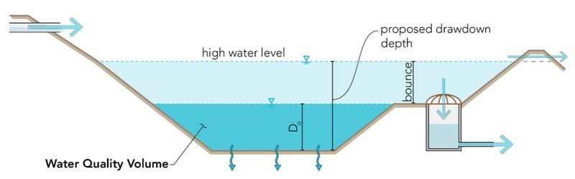
Drawdown and bounce

Slide 24
No change
Slopes in contributing drainage area < 15 percent
Soil infiltration rate > 0.2 inches per hour (A, B, C soil)
Do not use in active karst formations
Divert the water quality volume (V_{wq}) to the infiltration practice and allow larger flows to bypass the practice unless the infiltration practice is sized to retain larger volumes
If an infiltration system does not have an underdrain, it should be designed with dewatering provisions in the event of failure
Pretreatment required upstream of infiltration practice; manual provides guidelines for level of pretreatment
Longitudinal slope of practice: ideally 0 percent but up to 1 percent
Lateral slope of practice: 0 percent

Slide 25
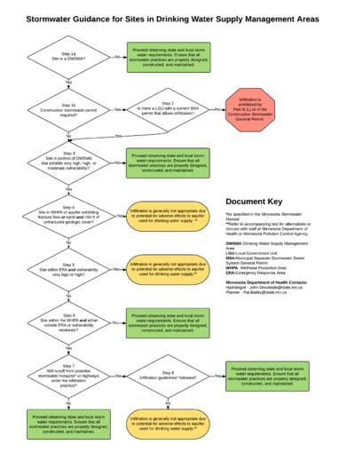
Maximum side slope for infiltration practice is 3:1 (h:v)
Depth is a function of drawdown time requirement
  78.2 inches for HSG A, GW and GP soils
  38.4 inches for HSG A, GM and SW soils
  21.6 inches for HSG B, SM soils
  14.4 inches for other HSG B soils
  9.6 inches for HSG C soils
  Max depth = 6.5 feet
Wellhead protection – guidance in manual

Slide 26
Landscaping
Integrate vegetated areas into site planning process
Select vegetation based on hydric tolerance
Native plant species preferred
Vegetation includes wild flowers, grasses, shrubs, and some trees
Keep woody vegetation out of pretreatment devices and be far enough away to not hamper maintenance of pretreatment devices.
Plant trees along perimeter and not over underdrains
Determine if salt resistant vegetation is needed
Plugs, bare root plants, potted plants, or sod RECOMMENDED over seed
Operate vegetated practices off-line until vegetation is established
Target plant coverage
  50% vegetation cover (100% for turf) at end of the first growing season
  90% specified vegetation cover at end of the third growing season
  Supplement plantings as needed

Slide 27
Snow considerations
Plan a plow path during design phase
Tell snowplow operators where to push the snow
Plan trees around (not in) plow path, with a 16 foot minimum between trees
Raingardens (bioretention) should be a last resort for snow storage (“emergency overflow”)
Snow storage could be, for example, a pretreatment moat around a raingarden

Slide 28
Design – Materials
Table - Infiltration media and material specifications

Slide 29
Design - Media

Slide 30
Two new media mixes added
Mix E - MnDOT 3877.2 Type G 'Filter Topsoil Borrow'
  60 to 80% sand meeting gradation requirements of 3126
  20 to 40% compost meeting requirements 3890 Grade 2 Compost
  Filtration rate of at least 4 in/hr
  Relatively inexpensive
  Nutrient release upon degradation of compost
Mix F: Custom Infiltration Basin Planting Soil
  75% by weight loamy sand (USDA Soil Textural Classification)
  25% by weight MnDOT grade 2 compost
  Good moisture holding capacity
  Lower infiltration rates, care to avoid compaction, requires custom mixing

Slide 31
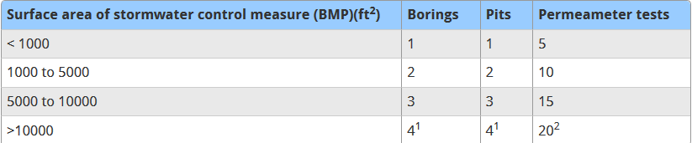
Design step process
No change
Determine if site conditions are appropriate for infiltration and how infiltration fits into the treatment system
Determine if Construction permit applies
Verify soil properties

Slide 32
Design step process (continued)
No change
Compute runoff volume(s); 1 inch if CSW permit applies
Select design variant (trench, basin, etc.) and size BMP
  Area = Runoff volume / depth of practice
Size outlet structure and/or flow diversion structure
Perform ground water mounding analysis
Determine pretreatment volume
Check volume, peak discharge rates and drawdown time
Prepare vegetation and landscaping plan
Prepare O & M plan
Prepare cost estimate

Slide 33
Construction specifications
Access agreements – section added that defines easements and includes example access agreement
Specifications
  Links to MnDOT specifications
  Pre-construction meeting, including site walkthrough
  Site protection: pretreatment, temporary erosion/sediment control, compaction prevention
  Inspection and documentation, including checklists

Slide 34
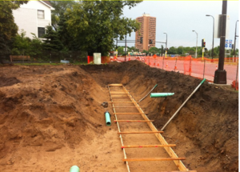
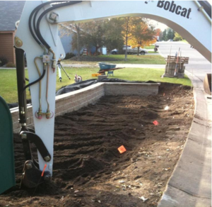
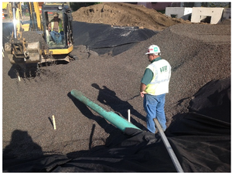
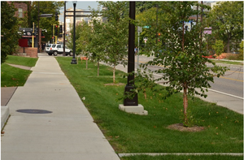
Construction sequence
Examine and mark site
Excavation
Decompaction to > 18 in below subgrade
Subsoil infiltration testing to ensure drawdown time is met
Installation of materials/media
Restoration and plantings
Stabilization and closeout

Slide 35
O & M – Design and Construction Phase Considerations
Maintenance burden can be minimized by considering these during design
  Limit drainage area to the BMP
  Provide easy site access
  Provide pretreatment
  Utilize native plantings
Inspections during construction ensure the infiltration practice is built in accordance with approved standards and specifications
  Use inspection form(s) – see link in manual

Slide 36
Post construction O & M considerations
Maintenance plan includes
  Inspection and maintenance checklists
  Operating instructions for outlet component
  Vegetation maintenance schedule
Have legally binding and enforceable maintenance agreement
Adequate access
Avoid compaction
Snow management
Maintenance activities and schedule

Slide 37
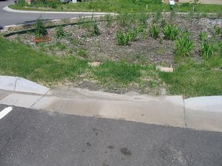
Typical Maintenance Regime
If vegetated, water first year after planting
As needed
  Prune and weed
  Stabilize/replace mulch and/or vegetation
  Remove trash/debris
  Mow filter strip
Semi-annually
  Inspect inflow, pretreatment systems, and filter strip
  Remove/replace vegetation as needed
Manual provides more detailed guidance on each of these, including estimated hours to perform maintenance activities

Slide 38
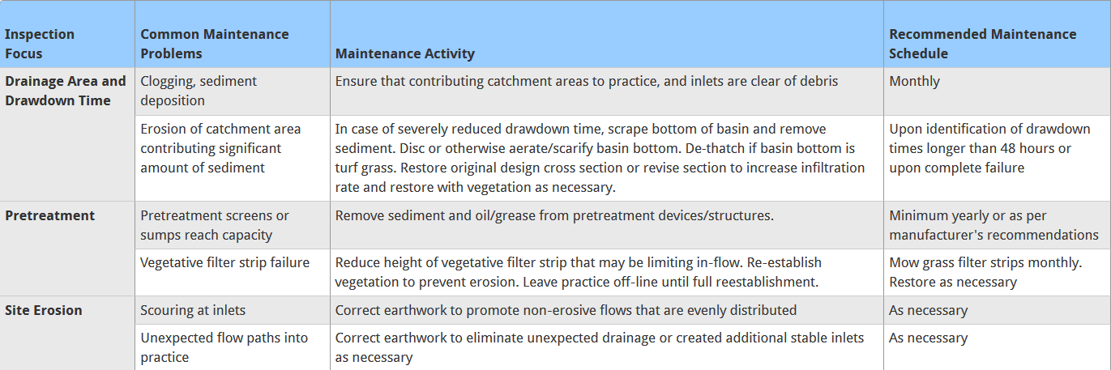
Typical maintenance problems and activities

Slide 39
Example list of standards in a Maintenance Agreement (vegetated system)
Plants shall be watered daily for two weeks after the garden installation is complete.
In the first year, rainwater gardens require vigilant weeding and should be weeded monthly. The need for weeding will decrease as plants become established.
Dead plant material and garbage or other debris shall be removed from the rain garden.
Areas devoid of mulch shall be re-mulched on an annual basis.
The rainwater garden shall be inspected annually for sediment trapped in the pretreatment area and in the garden itself. If possible, accumulated sediment should be removed.
Shrubs shall be pruned as necessary to keep a neat appearance.
Plants that do not survive shall be removed and replanted.
Side slopes must be inspected for erosion and the formation of rills or gullies at least annually and erosion problems must be corrected immediately.
If gardens are properly planned and designed (protected from sediment and compaction and incorporating a sufficient turf pretreatment area), a rainwater basin is likely to retain its effectiveness for well over 20 years. After that time, inspection will reveal whether sedimentation warrants scraping out the basin and replanting it (possibly with salvaged plants).

Slide 40
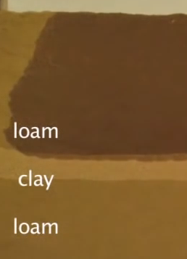
Understanding and interpreting soils and soil boring reports for infiltration BMPs
Objectives for collecting soil borings for stormwater infiltration practices differ from objectives for collecting borings for structural engineering purposes. Identification of low permeability or restrictive layers in soil are critical to proper design and construction of infiltration practices.
Source: Gembloux Agro-Bio Tech

Slide 41
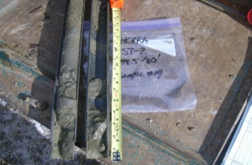
Recommended number of borings
¹ an additional soil boring or pit should be completed for each additional 2,500 ft² above 12,500 ft²
² an additional five permeameter tests should be completed for each additional 5,000 ft² above 15,000 ft²

Slide 42
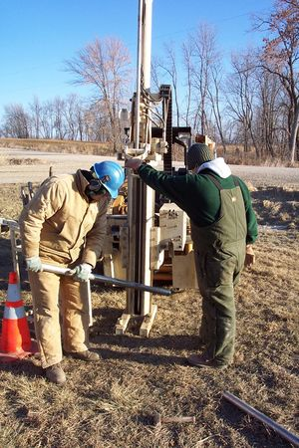
Types of soil sample collection methods
Soil probe
Hand held or machine auger
Excavation test pit or trench
Direct push technology (DPT)
Rotosonic drilling
Soil boring (hollow stem auger or HSA method)
Link to table

Slide 43
Disturbed vs. Undisturbed soil samples
A disturbed sample does not retain the in-situ structure of the soil. These types of samples can be used for classification tests such as the grain size analysis. Includes bulk samples, split-spoon samples, and continuous sampling methods.
Undisturbed samples are recovered completely intact and the in-situ structure and stresses are not modified in any way during collection. Samplers used to collect relatively undisturbed samples include Thin-wall, Modified California, Piston, and Pitcher. Undisturbed samples are generally not collected when trying to determine infiltration potential at a site as they do not allow collection of blow counts.

Slide 44
Drilling guidance
If recovery in a split-spoon sample is less than six inches, drill two feet deeper and perform another split-spoon sample.
If a confining layer is found, or there is low recovery in a split-spoon, reduce sampling intervals to every two feet. Record the presence of the most restrictive layer, even if that material is not the most abundant in the split-spoon sample.
If low recovery is encountered, explain in the field notes why the driller thinks this is happening (i.e. gravel in the shoe of the split-spoon)
Blow counts or “N” values found during a Standard Penetration Test (SPT) are critical to determining the presence of restrictive layers.
If soil boring auger refusal is encountered prior to depth desired, offset approximately five feet from initial borehole, blind -drill (continuous drilling without soil sampling) to refusal depth, and continue drilling/sampling from that point. Note there will be an additional cost associate with the offset and blind drill. If the second attempt results in the same refusal as the first, the driller should call the engineer to inquire about next steps immediately, prior to leaving the site. During that call, ask drillers to describe why they think refusal has been met and, if necessary to drill deeper, discuss alternative drilling methods or an additional offset.
Ask the driller to include soil type, recovery, blow counts, and presence of water in their field logs, and request a copy of their field logs.
It is highly recommended that the drillers use a standard form (attached). If they do not use a standard form, request to see their form prior to drilling and suggest modifications as necessary.

Slide 45
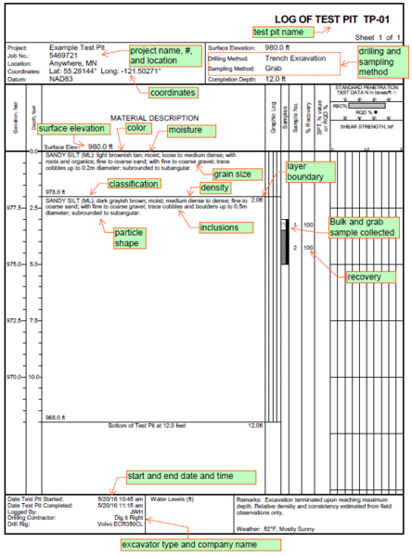
Information to include on a boring log link to table link to example boring logs

Slide 46
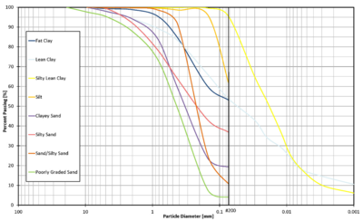
Additional information in the manual
Samples to collect for laboratory testing (PSD)
Discussion of restrictive layers in soil
Discussion of soil exploration reports
Resources, references, links

Slide 47
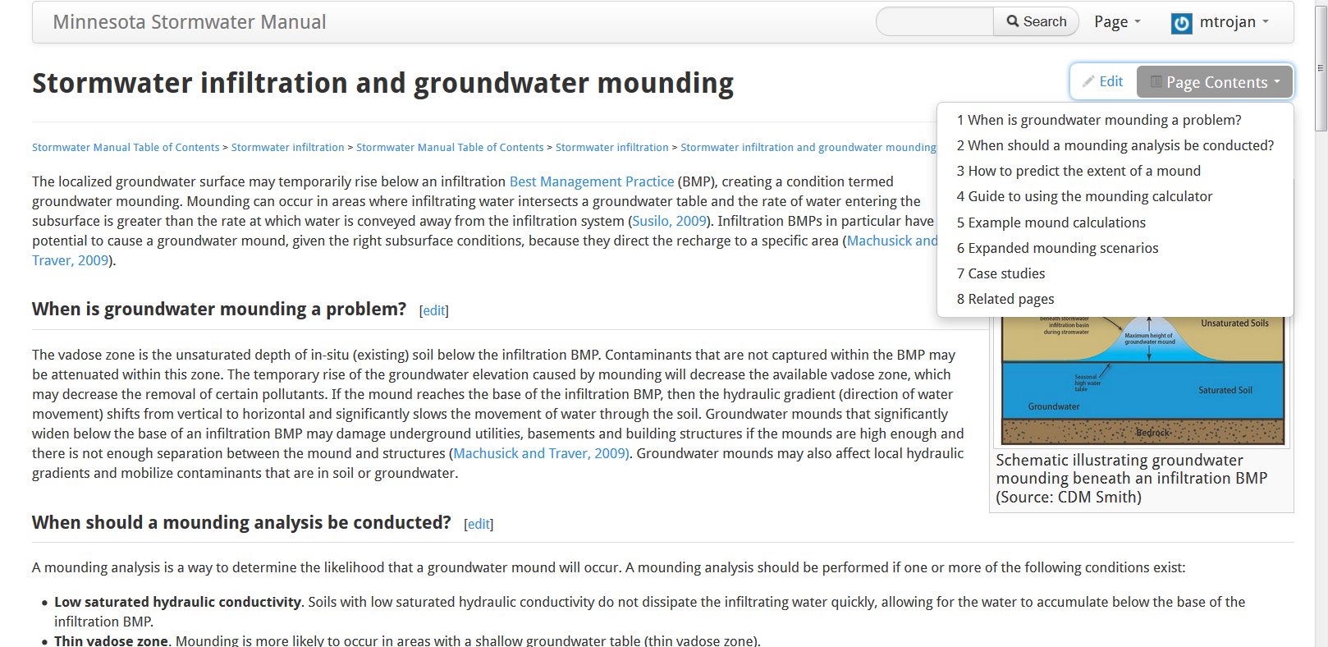
Groundwater mounding

Slide 48
Case studies - Link
Upper Villa Park Infiltration and Reuse, Capitol Region Watershed District, SRF Consulting Group, Inc., City of Roseville
Riverside Stormwater Park, City of Minneapolis
Rosetown American Legion Post 542 Infiltration Basin
We are always looking for good case studies. If you have a good case study, contact us and we can discuss.
We are always looking for good photos. Send them to us with the proper source crediting.

Slide 49
Questions?

Slide 50
Tour of Infiltration in the manual
Link to manual

Slide 51
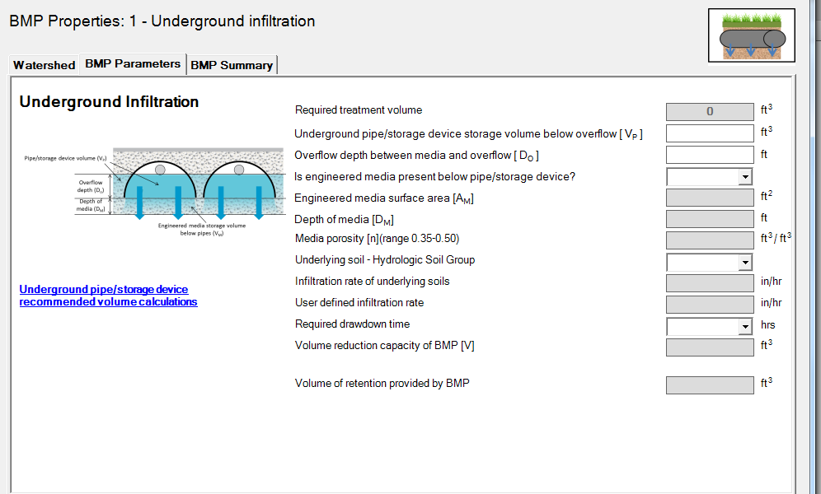
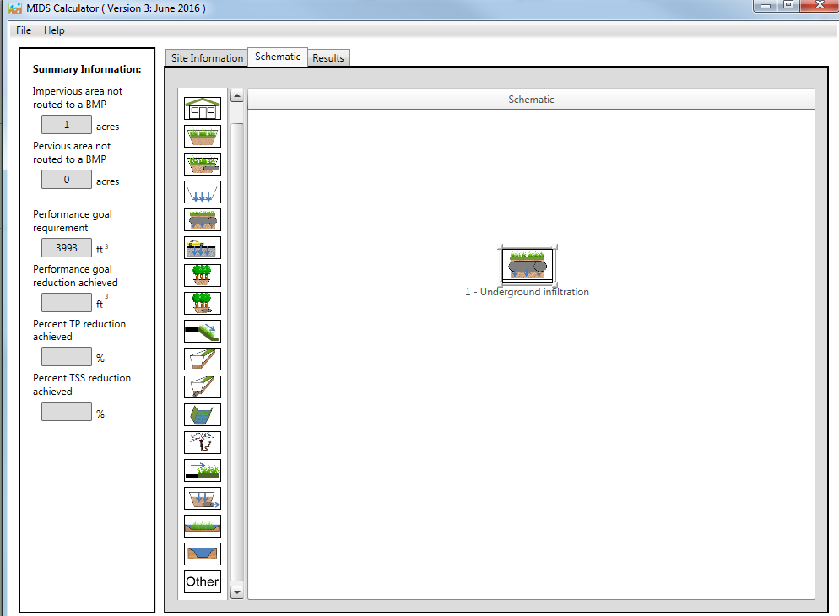
MIDS calculator
New BMP – underground infiltration

Slide 52
Questions?

Slide 53
Upcoming webcasts
Mid to late January: Stormwater/rainwater harvest and use/reuse
Mid March: Updates to the Minimal Impact Design Standards Calculator
Let us know what topics you are interested in

